Slide 1
Spring integration framework
Bhagwan Giri

Slide 2
1. Overview
Extends the Spring programming model to support the well-known Enterprise Integration Patterns.
Spring Integration enables lightweight messaging within Spring-based applications and supports integration with external systems via declarative adapters.
Spring Integration’s primary goal is to provide a simple model for building enterprise integration solutions while maintaining the separation of concerns that is essential for producing maintainable, testable code.

Slide 3
2. Goals and Principles
Provide a simple model for implementing complex enterprise integration solutions.
Facilitate asynchronous, message-driven behavior within a Spring-based application.
Promote intuitive, incremental adoption for existing Spring users.
Spring Integration is guided by the following principles:
Components should be loosely coupled for modularity and testability.
The framework should enforce separation of concerns between business logic and integration logic.
Extension points should be abstract in nature (but within well-defined boundaries) to promote reuse and portability.

Slide 4
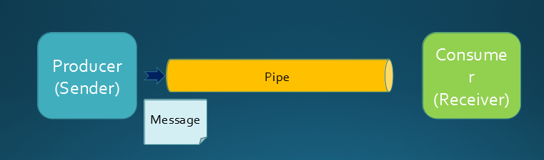
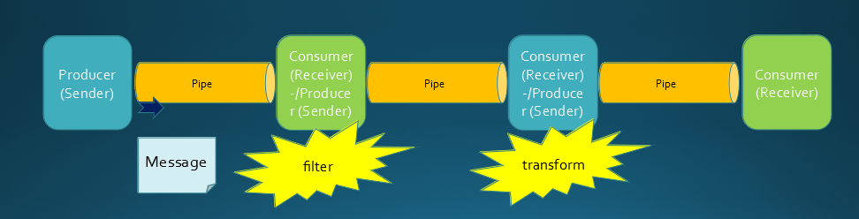
Spring integration application:

Slide 5
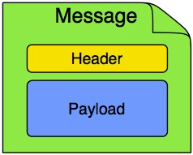
3.1 Component: Message
In Spring Integration, a message is a generic wrapper for any Java object combined with metadata used by the framework while handling that object.
It consists of a payload and headers.
The payload can be of any type.
The headers hold commonly required information such as ID, timestamp, correlation ID, and return address.
For example, when creating a message from a received file, the file name may be stored in a header to be accessed by downstream components.

Slide 6

3.2 Component: Message Channel
Two general classifications of message channels
Pollable Channel
Subscribable Channel
A message channel represents the “pipe” of a pipes-and-filters architecture.
Producers send messages to a channel, and consumers receive messages from a channel.
pollable channels are capable of buffering Messages within a queue.

Slide 7
3.3. Component: Endpoint
Not need to create producer or consumer, used IOC.
You should be able to focus on your specific domain model with an implementation based on plain objects
By providing declarative configuration, you can “connect” your domain-specific code to the messaging infrastructure provided by Spring Integration.
The components responsible for these connections are message endpoints.
The important thing is to achieve separation of concerns between the integration logic and the business logic.
primary role is to connect application code to the messaging framework and to do so in a non-invasive manner.

Slide 8
4. Message Endpoints
A Message Endpoint represents the “filter” of a pipes-and-filters architecture
Just as controllers are mapped to URL patterns, message endpoints are mapped to message channels.
isolate application code from the infrastructure.
Transformer:
A message transformer is responsible for converting a message’s content or structure and returning the modified message.
Similarly, a transformer can add, remove, or modify the message’s header values.
Filter:
A message filter determines whether a message should be passed to an output channel at all.
Have boolean method to check contain type, header and condition.
If the message is accepted, it is sent to the output channel. If not, it is dropped.

Slide 9
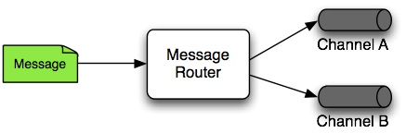
Continue..
Message Router:
A message router is responsible for deciding what channel or channels (if any) should receive the message next.
Decision is based upon the message’s content or the metadata available in the message headers.
Splitter:
Message endpoint whose responsibility
is to accept a message from its
input channel, split that message
into multiple messages. and send each of those to its output channel

Slide 10
Continue..
Aggregator:
mirror-image of the splitter, the aggregator is a type of message endpoint that receives multiple messages and combines them into a single message.
Service Activator:
A Service Activator is a generic endpoint for connecting a service instance to the messaging system.
The input message channel must be configured, and, if the service method to be invoked is capable of returning a value, an output message Channel may also be provided.
A request-reply service activator endpoint connects a target object’s method to input and output Message Channels.

Slide 11
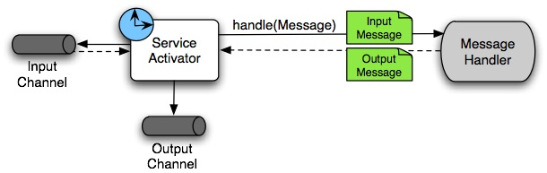
Continue..
The output channel is optional, since each message may also provide its own 'Return Address' header. This same rule applies for all consumer endpoints.

Slide 12
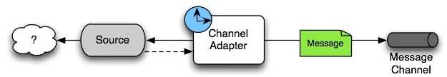
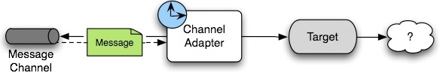
Continue..
Channel Adapter:
A channel adapter is an endpoint that connects a message channel to some other system or transport.
Channel adapters may be either inbound or outbound.
Adapter is the bridge between the two applications.

Slide 13
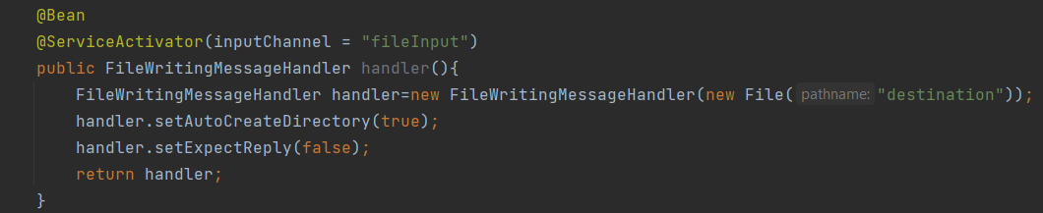
5. Endpoint Bean Names
Consuming endpoints (anything with an inputChannel) consist of two beans, the consumer and the message handler. The consumer has a reference to the message handler and invokes it as messages arrive.

Slide 14
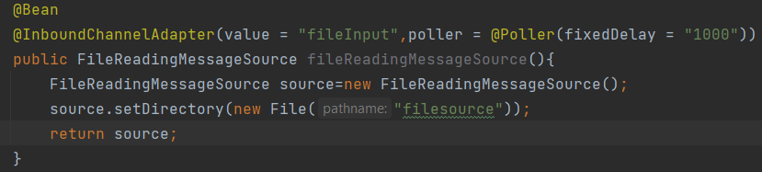
Continue..
Consider the following Java configuration of a bean to define an channel

Slide 15

6. Configuration and @EnableIntegration
The @EnableIntegration annotation registers many infrastructure components with the application context. In particular, it.
Registers some built-in beans, such as
errorChannel
LoggingHandler,
taskScheduler for pollers,
jsonPath SpEL-function.
Adds several BeanFactoryPostProcessor instances to enhance the BeanFactory for global and default integration environment.
Adds several BeanPostProcessor instances to enhance or convert and wrap particular beans for integration purposes.
Adds annotation processors to parse messaging annotations and registers components for them with the application context.

Slide 16
Questions?
Ref: https://docs.spring.io/spring-integration/docs/current/reference/html/overview.html#overview

Slide 17
Thanks for joining.

